Slide 1


IOT IN FLEET MANAGMENT IN LOGISTICS
CASE STUDY
Aditya S. Patil - 2223918
Tejas Raut - 2223910
Shruti Thorat - 2223901
Siddhart Dev - 2223902
Swaroop Jadhav - 2223907

Slide 2

INTRODUCTION
In the modern logistics industry, delivery companies face challenges such as vehicle maintenance, fuel efficiency, route optimization, and real-time tracking. The integration of the Internet of Things (IoT) in fleet management helps address these challenges by enabling real-time monitoring, predictive maintenance, and enhanced operational efficiency.

Slide 3

OVERVIEW
XYZ Logistics is a mid-sized delivery company with a fleet of 200 vehicles operating across multiple cities. The company faced issues related to inefficient routing, high fuel consumption, vehicle breakdowns, and a lack of real-time visibility into deliveries.

Slide 4

IMPLEMENTATION OF IOT IN FLEET MANAGEMENT
To overcome these challenges, XYZ Logistics implemented an IoT-based fleet management system with the following components:
GPS Tracking: IoT-enabled GPS devices were installed in all vehicles to provide real-time location updates and route optimization.
Telematics Sensors: Sensors were embedded to monitor fuel consumption, engine health, and driving behavior.

Slide 5

IMPLEMENTATION OF IOT IN FLEET MANAGEMENT
Predictive Maintenance: IoT sensors detected potential vehicle issues, reducing unexpected breakdowns and downtime.
Automated Alerts & Notifications: The system provided alerts for maintenance schedules, route deviations, and excessive idling.
Cloud-Based Analytics Dashboard: A centralized cloud platform provided insights into fleet performance and operational trends.

Slide 6

BENEFITS
The deployment of IoT in fleet management led to several improvements:
Reduced Fuel Costs: By optimizing routes and reducing idling time, fuel consumption was reduced by 15%.
Enhanced Delivery Efficiency: Real-time tracking and automated dispatching improved delivery times by 20%.
Lower Maintenance Costs: Predictive maintenance led to a 25% reduction in repair costs.

Slide 7
BENEFITS
Improved Driver Safety: Monitoring driving patterns helped in reducing harsh braking and over-speeding incidents.
Better Customer Satisfaction: Real-time tracking allowed customers to get accurate delivery estimates, increasing transparency and trust.

Slide 8
CHALLENGES & SOLUTIONS
Data Security Concerns: Secure encryption and access controls were implemented to protect fleet data.
Initial Investment Costs: Although the upfront costs were high, long-term savings in fuel and maintenance justified the investment.
System Integration Issues: Ensuring seamless integration with existing ERP and logistics software required customized APIs.

Slide 9
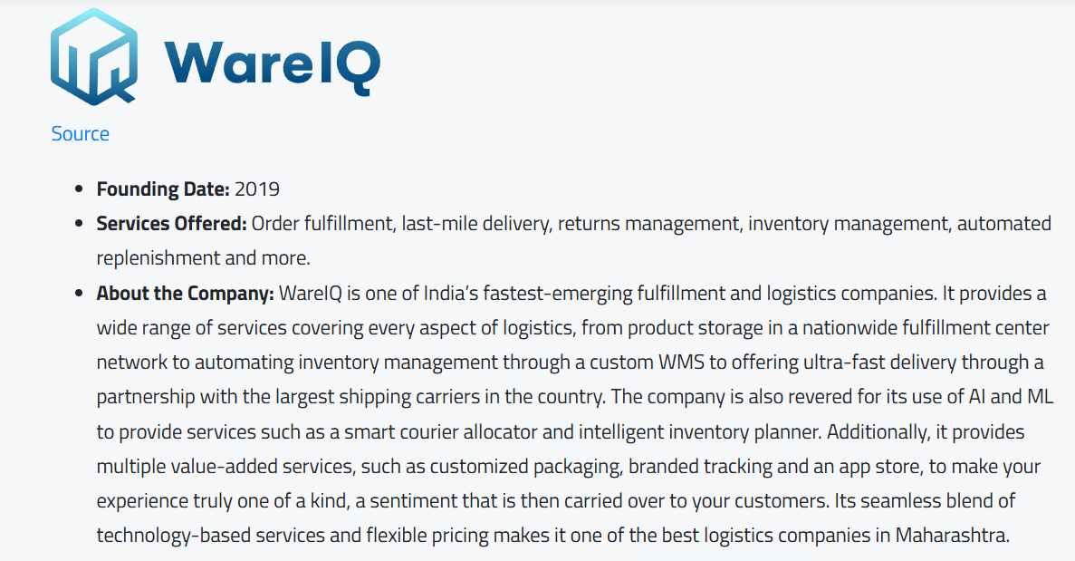
REAL LIFE EXAMPLE

Slide 10

CONCLUSION
The implementation of IoT in fleet management transformed XYZ Logistics’ operations by improving efficiency, reducing costs, and enhancing customer satisfaction. As technology continues to evolve, further innovations such as AI-driven route optimization and autonomous fleet management can further enhance logistics operations.

Slide 11

FUTURE SCOPE
XYZ Logistics plans to integrate AI and machine learning to further optimize routing and predictive analytics. Additionally, electric vehicle (EV) fleet integration with IoT can drive sustainability initiatives while improving cost efficiency.

Slide 12
THANK YOU!

